Slide 1

Online Pizza Delivery System with Spring Boot and MySQL
This presentation introduces a modern web application. It facilitates seamless pizza ordering and delivery. Built using Java Spring Boot framework and MySQL. It offers a scalable, efficient, and user-friendly platform.
By VINOTH P

Slide 2
Technology Stack
Backend
Database
Frontend
Spring Boot 2.7.x (or latest), Java 11 (or later). Spring Data JPA simplifies database interactions. Spring Web MVC handles RESTful API endpoints.
MySQL 8.x stores pizza menu, customer orders, and delivery information. Spring Security secures the application.
React, Angular, or Vue.js. Build Tool: Maven or Gradle. Deployment: Docker, AWS, or any cloud platform.

Slide 3
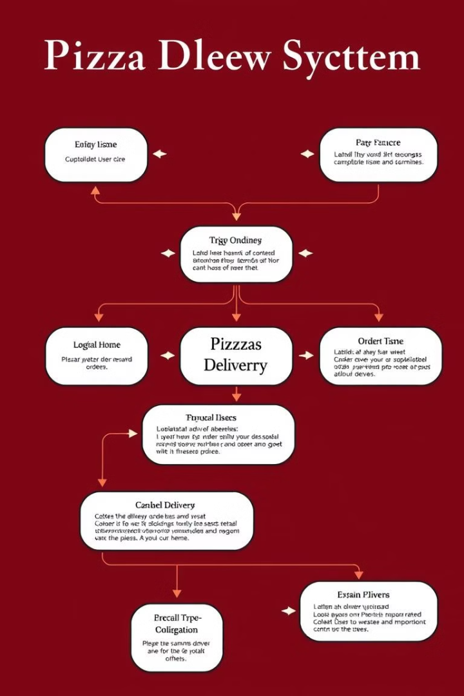




System Architecture
Presentation Layer
(Frontend) User interface for placing orders.
Application Layer
(Backend - Spring Boot) REST controllers handle API requests.
Data Layer
MySQL database storing persistent data.
External APIs
(Optional) Payment gateway integration. Mapping services for delivery tracking.

Slide 4

Database Design
Table
Columns
customers
customer_id, name, address, phone_number
pizzas
pizza_id, name, description, price
orders
order_id, customer_id, order_date, total_amount, status
order_items
order_item_id, order_id, pizza_id, quantity
delivery_drivers
driver_id, name, vehicle_type
deliveries
delivery_id, order_id, driver_id, delivery_address, delivery_time

Slide 5

Key Features
1
Online Ordering
2
Order Management
3
Delivery Management
User-friendly menu browsing. Customizable options. Shopping cart functionality. Secure checkout.
Real-time tracking for customers. Order status updates. Admin panel.
Assignment of orders to drivers. Driver location tracking. Delivery time calculation.

Slide 6
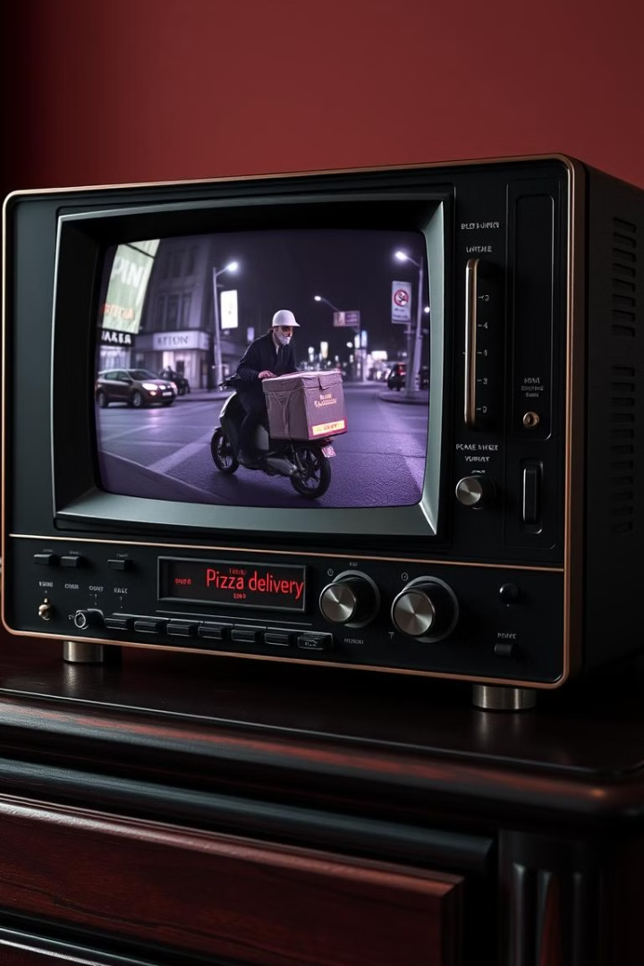
Demo
Customer Ordering
Admin Panel
Showcasing order management.
Ordering a pizza as a customer.
Delivery Driver
Tracking deliveries.

Slide 7



Challenges and Solutions
Security
2
Spring Security, input validation.
Scalability
1
Database sharding and caching.
Data Consistency
3
Distributed transactions.

Slide 8

Conclusion
Spring Boot and MySQL offer a robust solution. The system is user-friendly for customers. It provides efficient management tools for administrators.
Future enhancements: AI-powered pizza recommendations. Loyalty programs. Integration with social media.

